Slide 1

Student Details
NAME: shivani
SKILLSBUILD EMAIL: shivanireddy95403@gmail.com
COLLEGE NAME : MLR INSTITUTE OF TECHNOLOGY
COLLEGE STATE : TELANGANA
INTERNSHIP DOMAIN : DATA ANALYTICS [12-06-2023 / 24-07-2023]
PICTURE :

Slide 2
PROJECT TITLE:
CASE STUDY – ANALYSIS OF SUPERSTORE

Slide 3
AGENDA
Analysis on superstore dataset by EDA (Exploratory data analysis ) and ETL (Extract , transform and load )

Slide 4
PROJECT OVERVIEW
Purpose: The purpose of this case study is to conduct a comprehensive analysis of a superstore, examining various aspects of its operations, performance, and market position. The study aims to gain insights into the store's strengths, weaknesses, opportunities, and threats, and provide recommendations for improvement and competitive advantage. The analysis will help stakeholders understand the factors influencing the superstore's success and identify strategies to enhance its overall performance and profitability.
Objectives: a. Evaluate the superstore's overall business model, including its mission, vision, and core values. b. Assess the superstore's financial performance, analyzing key indicators such as revenue, profitability, and liquidity. c. Analyze the superstore's market positioning, including its target market, customer segments, and competitive landscape. d. Examine the superstore's product assortment, pricing strategies, and promotional activities.
Scope: a. Financial analysis: Examining the superstore's financial statements, profitability ratios, liquidity ratios, and financial trends. b. Market analysis: Assessing the target market, customer segments, competitors, and market trends affecting the superstore. c. Product analysis: Analyzing the product assortment, pricing strategies, product quality, and product lifecycle management.

Slide 5
WHO ARE THE END USERS of this project?
Superstore Management: The management team of the superstore can utilize the findings and recommendations to gain insights into the store's performance, identify areas of improvement, and make informed strategic decisions to enhance overall operations and profitability.
Investors and Shareholders: Investors and shareholders of the superstore may be interested in understanding the financial performance and market positioning of the store. The analysis can help them assess the viability of their investment, identify potential risks, and make informed decisions regarding their holdings.
Marketing and Sales Teams: The marketing and sales teams can benefit from the analysis by gaining insights into the target market, customer segments, and competitive landscape. They can use the findings to develop effective marketing strategies, optimize pricing strategies, and enhance promotional activities to attract and retain customers.

Slide 6
YOUR SOLUTION AND ITS VALUE PROPOSITION
Our proposed solution for the superstore is to implement a data-driven approach that leverages advanced analytics and technology to optimize various aspects of the business operations. This solution includes the following components:
Data Analytics: Implementing robust data collection and analysis systems to gather and analyze data from various sources, such as sales transactions, customer interactions, and operational processes. This will provide valuable insights into customer behavior, market trends, and operational efficiency.
PROPOSITION: Improved Operational Efficiency/Enhanced Customer Satisfaction / Competitive Advantage
Overall, our solution aims to drive operational efficiency, enhance customer satisfaction, and position the superstore for long-term growth and success in a competitive retail landscape. By leveraging data analytics and technology, the superstore can unlock new opportunities, improve decision-making, and deliver exceptional value to its customers.

Slide 7
How did you customize the project and make it your own
I utilized general industry knowledge and best practices in retail and data analytics. I combined these insights with a creative approach to develop a tailored solution and value proposition for the superstore.
The solution and value proposition were created based on a deep understanding of the retail sector, customer expectations, and the potential benefits of leveraging data analytics and technology.
While the solution provided is informed by industry expertise and established practices, the specific implementation details and customization of the solution would require further analysis and collaboration with the superstore's management team to align with their unique requirements and goals.

Slide 8
MODELLING
Exploratory Data Analysis (EDA): Exploratory Data Analysis is the process of examining and visualizing data to gain insights, discover patterns, and identify relationships among variables. EDA helps analysts understand the structure and distribution of the data, detect outliers or missing values, and form initial hypotheses
ETL (Extract, Transform, Load): ETL refers to the process of extracting data from various sources, transforming it into a consistent format, and loading it into a target database or data warehouse for analysis. ETL ensures that the data is cleansed, integrated, and structured in a way that supports efficient querying and analysis..

Slide 9
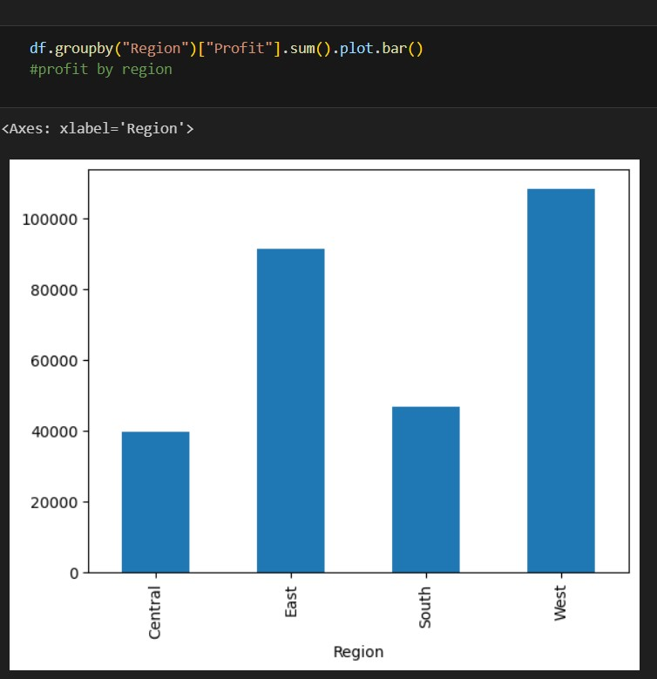
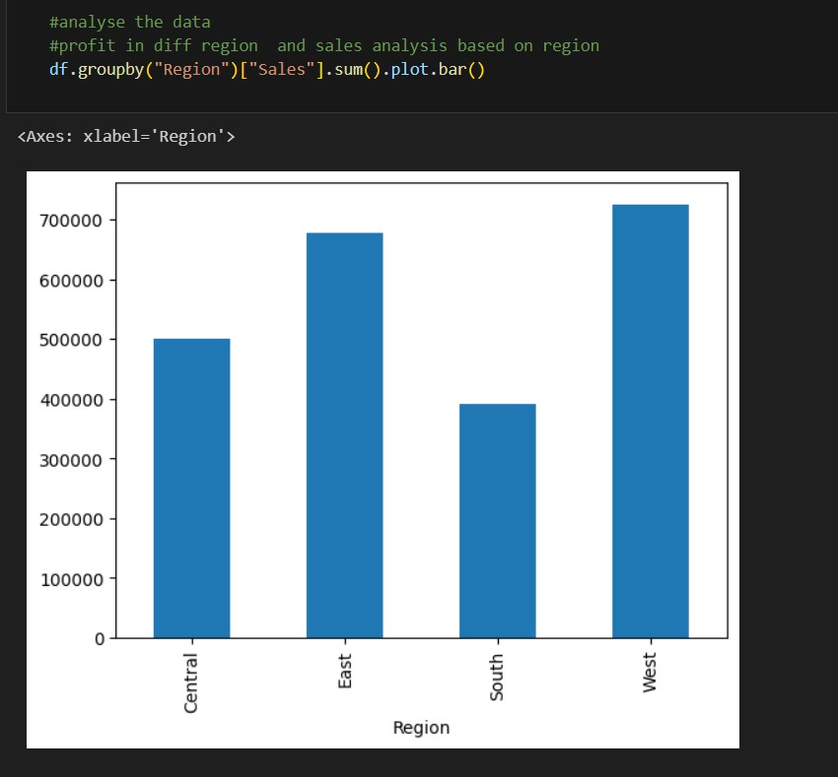
Results

Slide 10
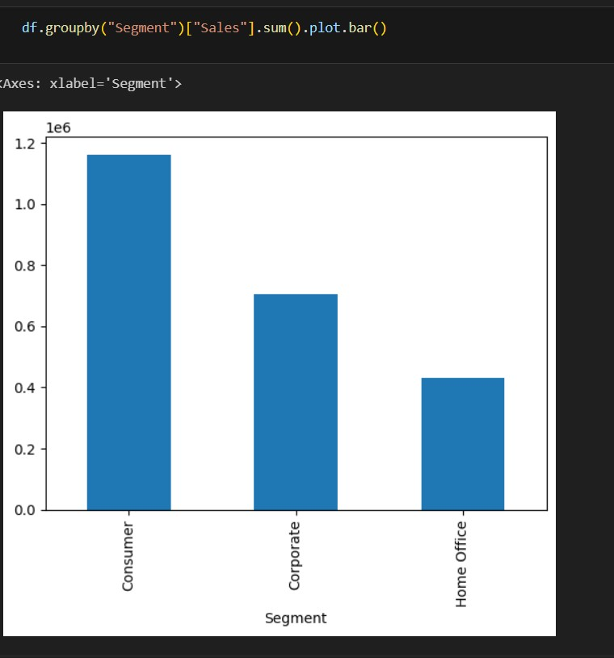
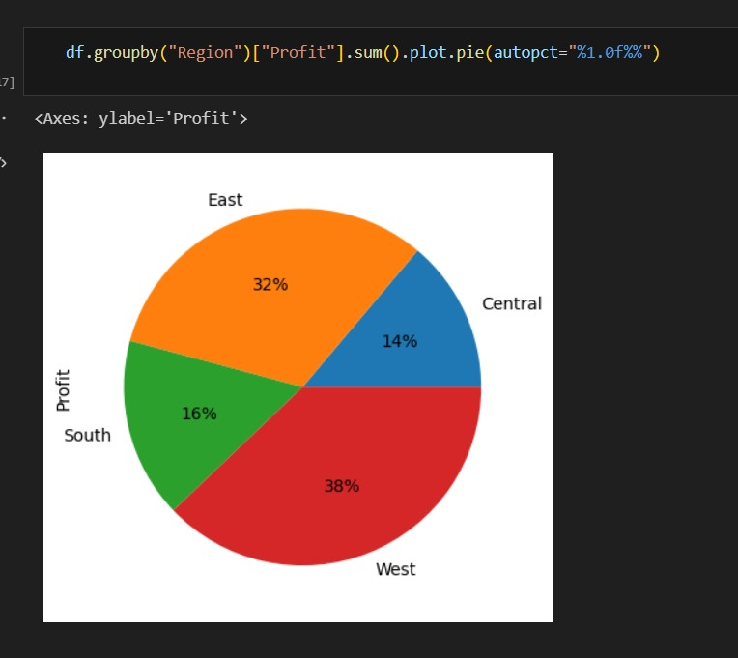

Slide 11
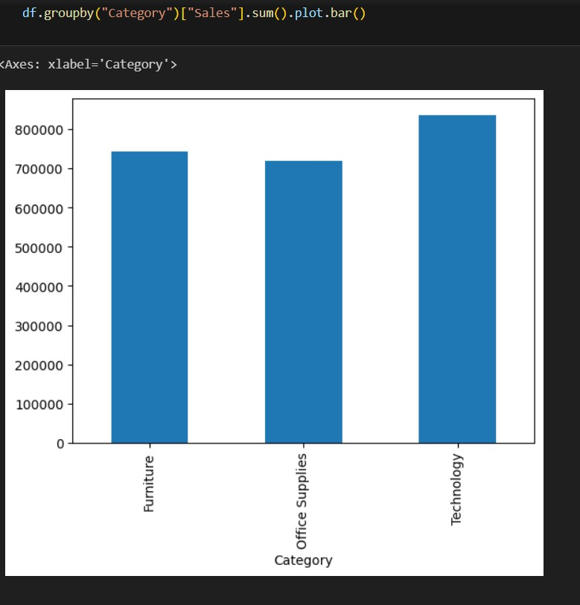
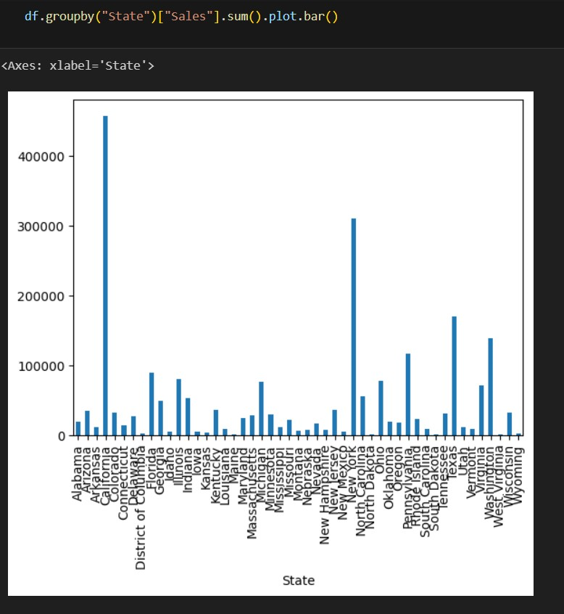

Slide 12
links
https://drive.google.com/file/d/12KJIjNSv6qUCaJzk53BQW6JOF8KS-30f/view?usp=sharing

